Slide 1
SYSTEMART, LLC
We Optimize. You Capitalize
Staffing Services

Slide 2
Content
Staff Augmentation Services
Areas of Expertise
Experience: Types of positions
Client Engagements
Recruiting Process Services
Value Proposition
www.systemart.com
2/12

Slide 3
Staff Augmentation Services
Service Portfolio:
Contract
Contract to Hire
Permanent Hire
Geographic Coverage:
North America: USA, Canada
Europe
India
www.systemart.com

Slide 4
Areas of Expertise
Area of Expertise
Information Technology
Manufacturing & Engineering
Healthcare and Pharmaceutical
HR, Finance & Accounting
Administrative & Clerical
Other Professional
Services
www.systemart.com

Slide 5
Experience: Positions: Non- IT
Pharmaceutical | Health Care | Engineering | Finance & Accounting | HR & Others
Clinical Research Coordinator | Traveling Nurses | QA & Validation Engineer | Financial Analyst | HR Generalist
Drug Safety Associate | Diem Nurses | Mechanical Engineer | Sales & Use Tax Consultant | Contracts Specialist
Senior Scientist | Nurses | Industrial Engineer | Accountant | Collections Admin
Regulatory Affair Associate | Physicians | Electrical Engineer | Controller | Legal Secretary
Quality Control Specialist | Health Care Administration | Professional Engineer | Reconciliation Specialist | Sales Analyst
Pharmacovigilance Specialist | Insurance Claim Proceser | Project Engineer | Forensic Accounting | Marketing Manager
www.systemart.com

Slide 6
Experience: Positions: IT
Information Technology
.NET Developer | Integration Architect | Enterprise Architect | Systems Admin
Mobile Application developer | SAS Consultant | Data Analyst | Database Administrators (DBA)
Web Designer | Big Data Developer | Business Systems Analyst | Server Support
Java Developer | Informatica consultant | Team Lead | Helpdesk Support
UI Designer | SAP Consultant | Project Manager | Network Engineer
Quality Assurance Testers | Micro Strategy Consultant | Project Coordinator | Data Center Consultant
www.systemart.com

Slide 7
Client Engagements
Client Industries
Auto Manufacturing and finance Corp | Oil and Gas Industry
Hospitality companies | Healthcare providers
Aerostructures manufacturer | Publishing
Accounting and Finance | Utility
IT / Software companies | Pharmaceutical
www.systemart.com

Slide 8
Recruiting Process Services
www.systemart.com

Slide 9
Recruiting Process Services
The Recruiting Process ( RPS ) Portfolio includes:
End to End RPS - Managing entire recruitment life cycle
Selective RPS – Management of recruitment components ( e.g. sourcing, screening, etc. )
On Demand RPS - Management of short term projects and pilots
Research the market for other avenues to source candidates
Provide a dedicated team of recruiters, sourcers and advance Sourcers
www.systemart.com

Slide 10
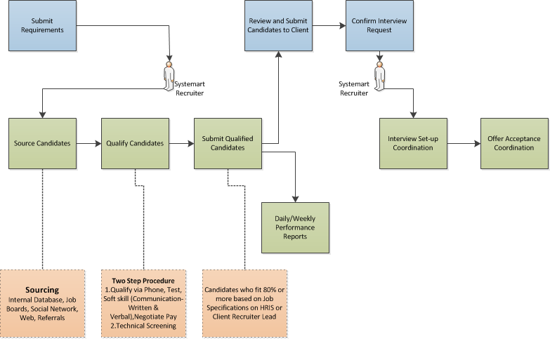
Recruiting Process Flow Diagram
Functions:
Client Recruiter
1. Submit Requirements
2. Submit Qualified Candidates to Client
3. Confirm Interview Request
Systemart Recruiters
1. Source Candidates
2. Qualify Candidates
3. Submit Candidates to Client Recruiter Lead
4. Interview Coordination
5. Offer Acceptance Coordination
6. Daily/Weekly Performance Reports

Slide 11
Value Proposition
Experience with Major Managed Service Providers & Vendor Management Systems (MSP, VMS)
Source from multiple channels (Internal Database, Job Boards, Social Media Sites, Passive Recruiting, Web)
Time Tested Candidate Identification and Qualification Process
Multiple level of Qualification Process (HR, Technical, Online tests)
Reduce the Operating costs (30% to 50% Reduction in Costs )
www.systemart.com

Slide 12
Thank you!
Systemart LLC
Sales@systemart.com
Phone Number:- 9739174848
www.systemart.com
www.systemart.com

